Slide 1

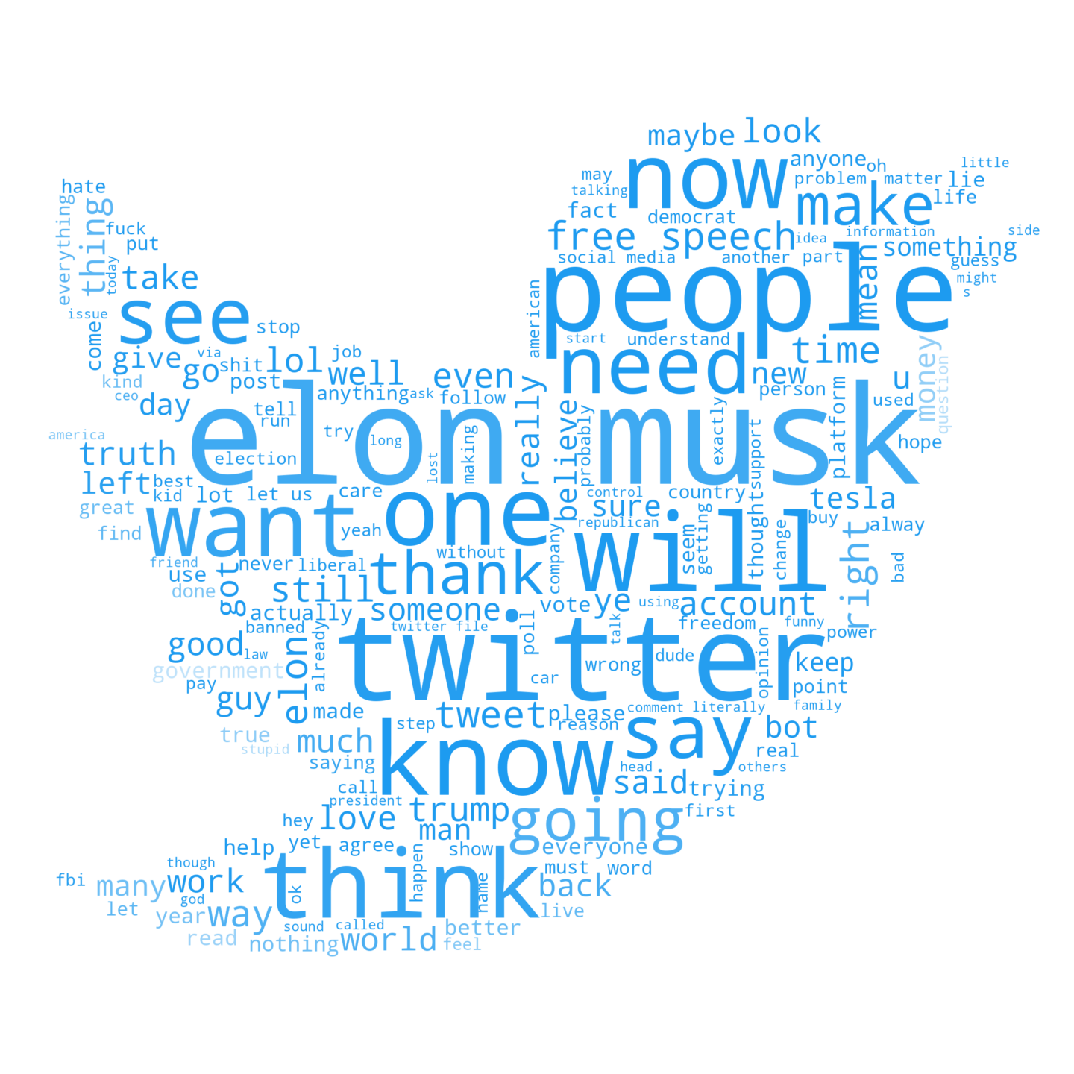
Twitter Under the Microscope: Unveiling Emotions with NLP Twitter Sentiments through Machine Learning and Visualization
Twitter sentiment analysis is a powerful tool that can provide valuable insights into people's opinions and attitudes. In this presentation, we will explore how sentiment analysis can be used in machine learning and how it can help businesses make informed decisions.
Rutuja Pokharkar – 233532
Madhura Patil --233522

Slide 2

Understanding Twitter Sentiment-Analysis
1
What is Sentiment Analysis?
2
Why is it Important?
3
How Does it Work?
Sentiment analysis can help businesses understand public sentiment and make data-driven decisions, such as improving customer experience, marketing strategies and product development.
Sentiment analysis works by analyzing text inputs, such as tweets, and categorizing them into positive, negative or neutral categories based on their context.
It is a process of understanding and analyzing people's opinions, attitudes, and emotions on a particular topic or subject.

Slide 3

Project Objective and Scope
Objective
To classify public Twitter sentiment as positive, negative, or neutral and generate insightful visualizations of sentiment trends.
Scope
This project employed advanced Natural Language Processing techniques, machine learning models, and data visualization techniques to analyze Twitter data.

Slide 4
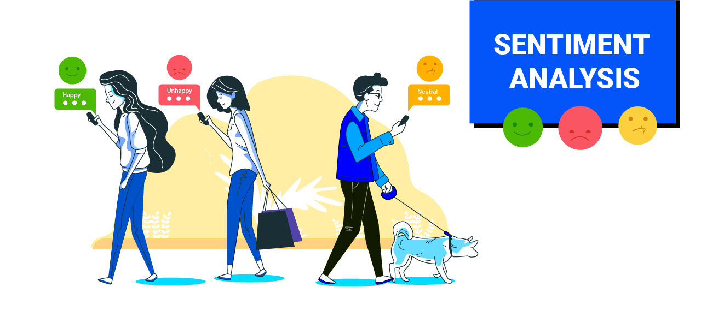
Import Libraries and Load Dataset
Libraries
Pandas,numpy,matplotlib.pyplot ,seaborn,re string,nltk
TextBlob,WordCloud,Warnings,matplotlib inline
https://drive.google.com/file/d/1I9c4N54zwlHz0ZLQcXe_eX_q0NauuYgr/view?usp=drive_link
[74682 rows x 4 columns]
/content/Twitter_tweets.csv/content/Twitter_tweets.csvhttps://drive.google.com/file/d/1I9c4N54zwlHz0ZLQcXe_eX_q0NauuYgr/view?usp=drive_linkhttps://drive.google.com/file/d/1I9c4N54zwlHz0ZLQcXe_eX_q0NauuYgr/view?usp=drive_link

Slide 5



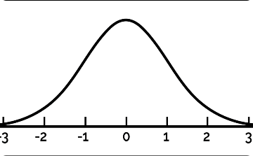
Preprocessing
Null Values
Stop Words
Ensure no null values exist.((73996, 4))
(73996
Remove stop words (a, an, the , etc).
Contractions
Normalization
Handle contractions (convert "don't" to "do not").
Normalize text (lowercase, stemming).

Slide 6
Text Processing and Sentiment Analysis
Polarity & Subjectivity
Calculate polarity (positive/negative) and subjectivity (opinion/objective score).
1
2
3
Textblob Library
Classification
TextBlob performs sentiment analysis and does processing.
Classify tweets into positive, negative, and neutral sentiment categories.

Slide 7
Data Splitting and TF-IDF Vectorization
1
Data Splitting
Using `train_test_split` from sklearn, split the data into training and testing sets
TF-IDF Vectorization
2
TF-IDF is a technique in natural language processing (NLP) which weighs the importance of words in a document relative to a collection of documents. Useful for tasks like text classification, information retrieval, and text mining.
3
Feature Extraction
Feature extraction process for creating a numerical representation of text data.

Slide 8
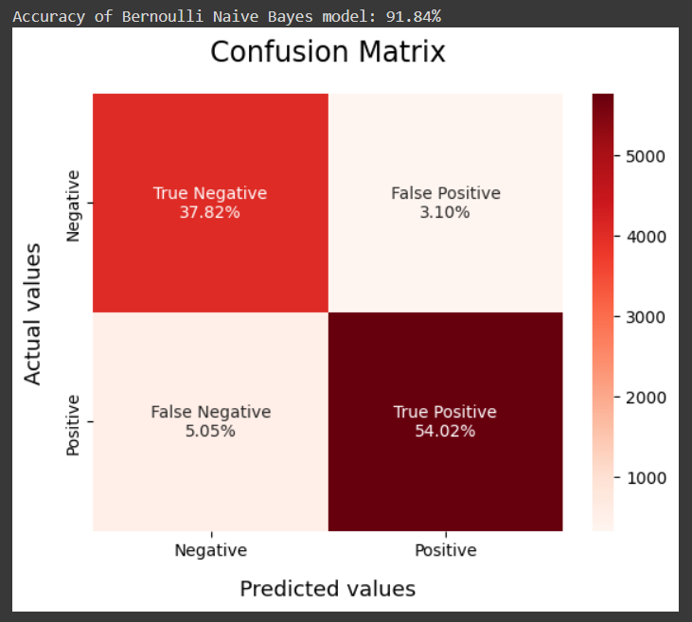
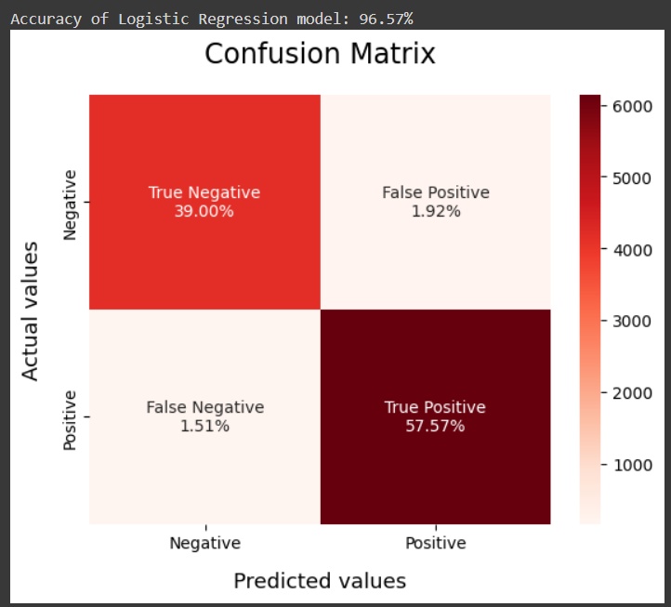
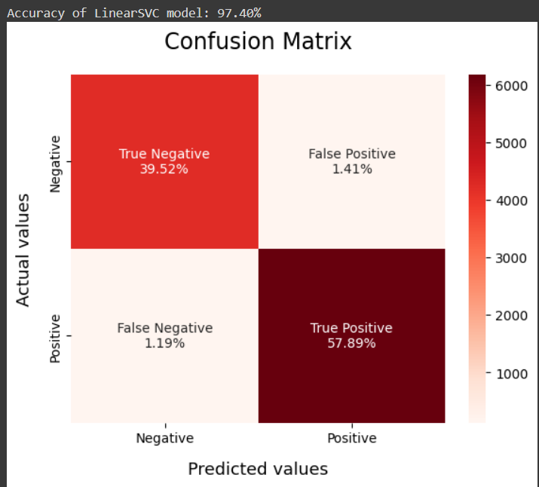
Model Selection and Evaluation
Classification Models
Use of different classification models: Bernoulli Naive Bayes model, Logistic Regression and SVM (Support Vector Machine)

Slide 9
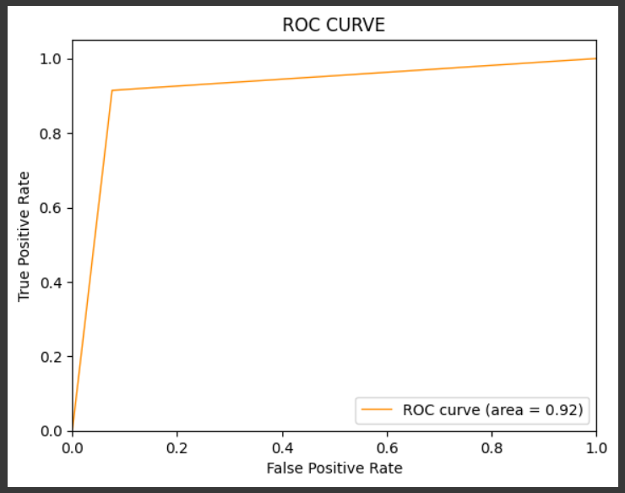
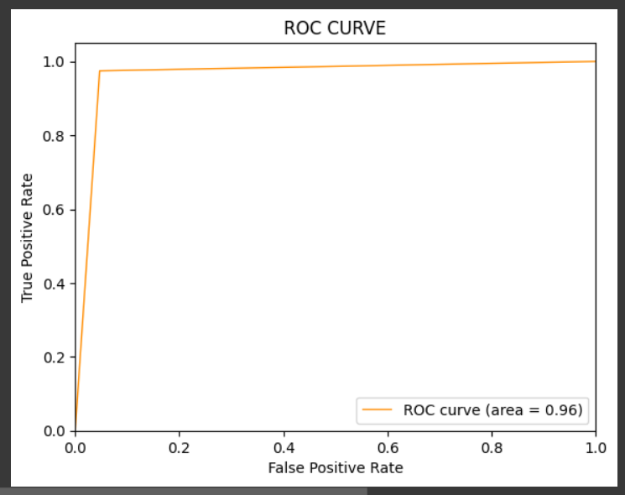
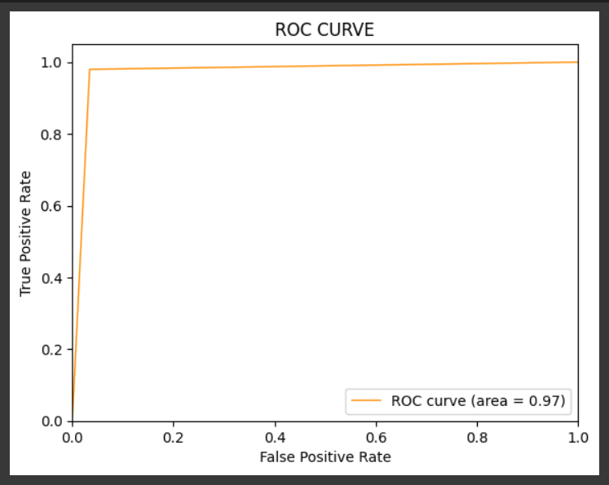
Model Evaluation
Evaluating models using accuracy, confusion matrix, ROC curve, and AUC of Bernoulli Naïve Bayes Classifier , Logistic Regression and Linear SVM respectively.

Slide 10
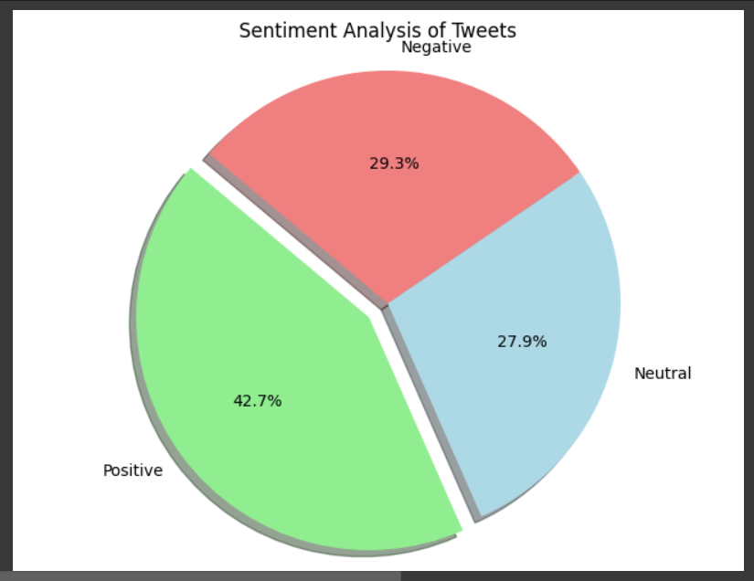
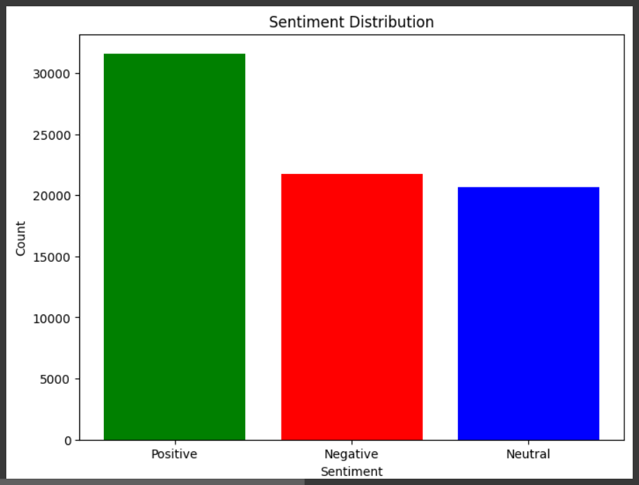
Results Achieved
Accuracy
We achieved high accuracy given by the model named Linear SVM of 97.40 %
Insightful Visualizations
The visualizations generated gave insights into popular subjects including sports and entertainment.
Continuous analysis
Our program has been ensuring continuous analysis and charts of sentiments.

Slide 11

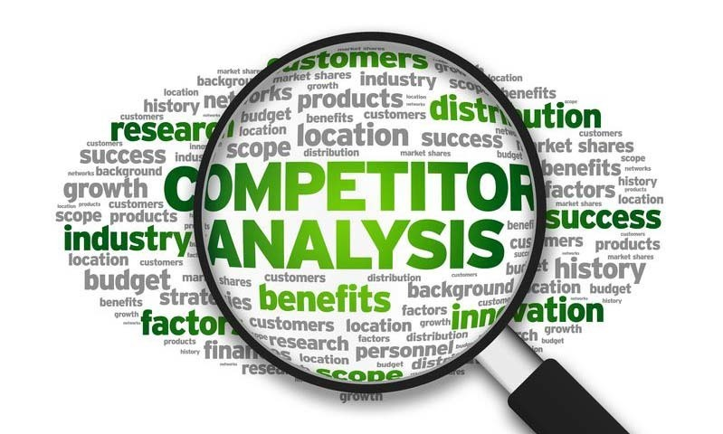
Extracting Insights from Twitter Data
1
Market Research
2
Trend Analysis
3
Competitor Analysis
Understand customer needs and preferences to shape business strategy.
Track popular topics and industry trends in real-time, staying ahead of competitors.
Examine sentiment towards competitors, uncovering strengths and weaknesses to enhance your own business.

Slide 12

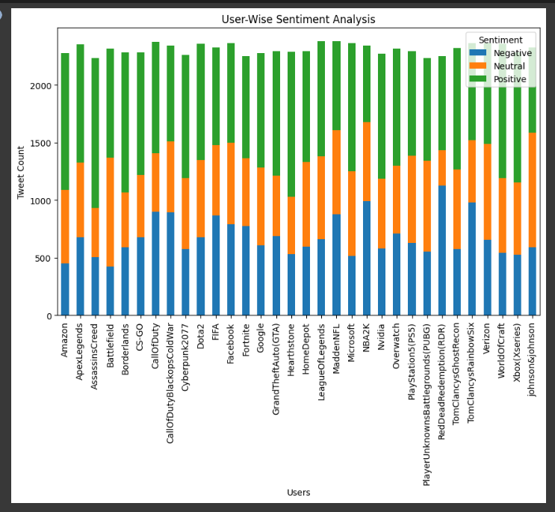
User-Based Sentiment Analysis
User Grouping
Word Frequency Analysis (tweet count vs user)
Group users into categories (e.g. Technology Companies) and count their positive/negative tweets.
Explaining the importance of analyzing user-based sentiment and word frequencies.

Slide 13
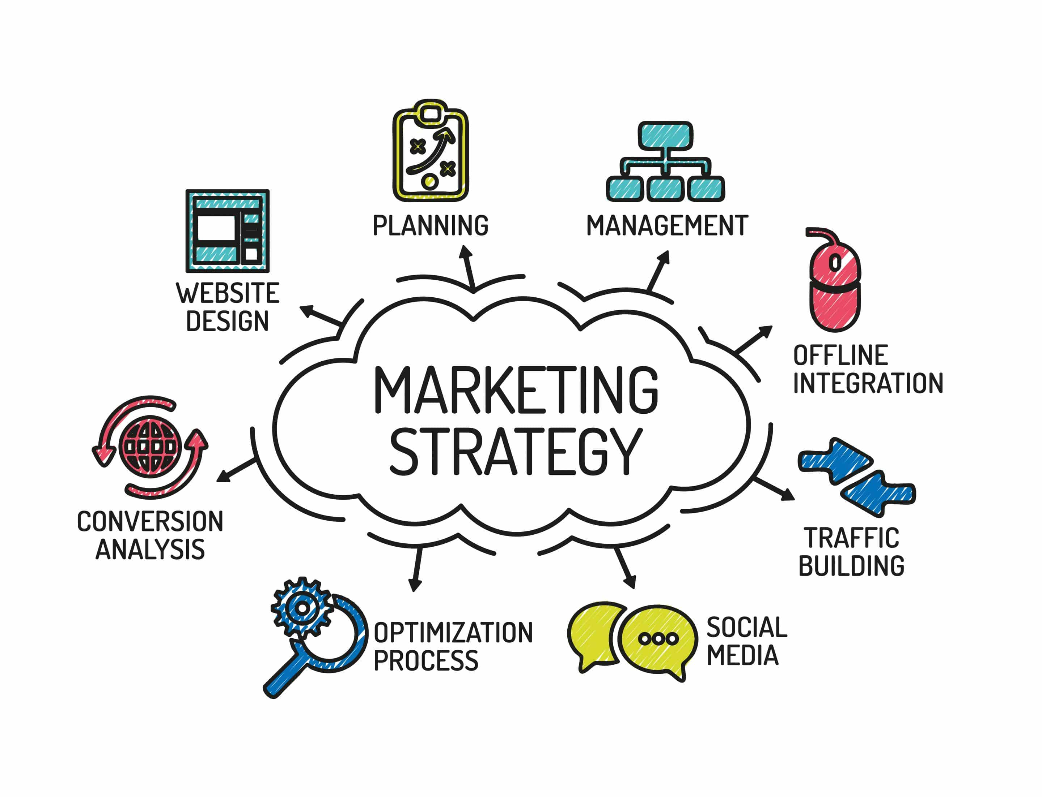


Analyzing Twitter Data for a Company Brand
Brand Perception
Marketing Strategy
Customer Service
Analyze brand customer perception and opinions on social media.
Utilize sentiment data during planning stages to improve marketing campaigns.
Keep track of customer satisfaction through sentiment analysis.

Slide 14
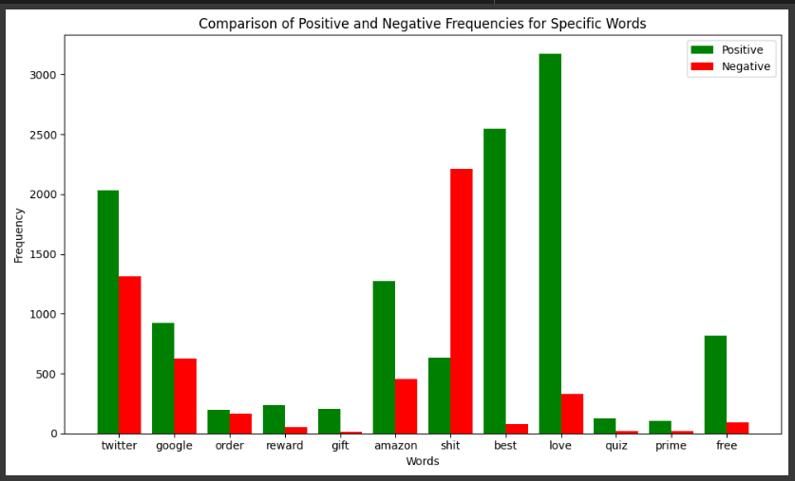
Most Frequent Words Analysis
Category Analysis
Analyzing the most frequent words in a specific category (e.g. Amazon).

Slide 15
Specific Word Analysis
1
Word Analysis
Analyzing the specific words (e.g., 'twitter', 'amazon', 'love') for positive and negative frequencies.
Creating a DataFrame
2
DataFrame to compare word frequencies.
3
Sentiment Trend Analysis
Significance of analyzing specific words for sentiment trends.

Slide 16
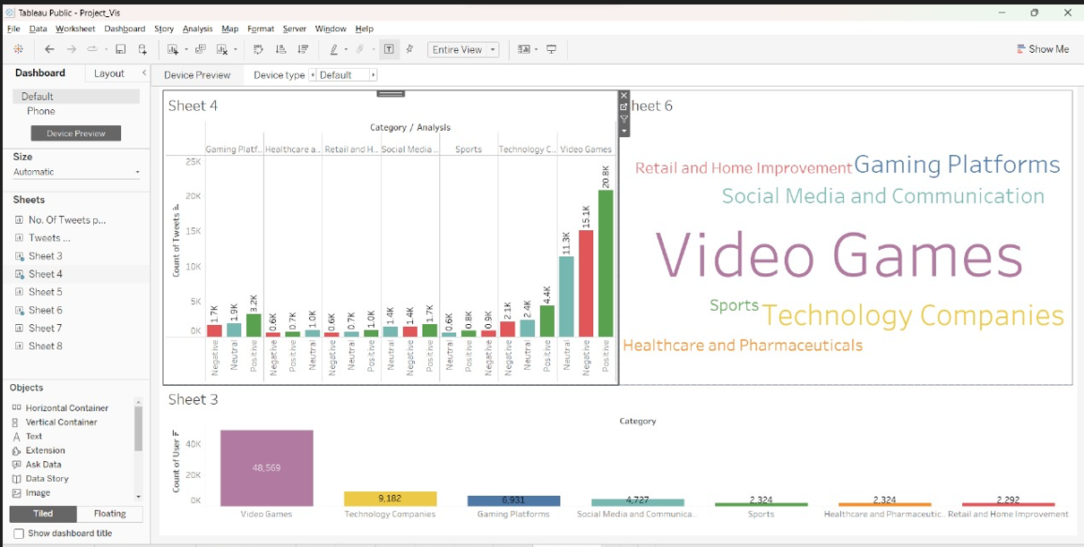
Visualization
Pie Charts
Bar Plots
Use pie charts to visualize positive and negative word frequency for a specified category.
Demonstrate the use of bar plots to visualize the frequency of specific words in a sentiment analysis.

Slide 17
Evaluating the Performance
Accuracy Metrics
Future Scope
Conclusion
Accuracy, precision, recall, and F1-score can be used as metrics to evaluate the performance of the sentiment analysis model.
The developed model can be further improved by using advanced techniques such as neural networks and deep learning. It can also be used for real-time sentiment analysis.
Sentiment analysis is a powerful tool that can unlock valuable insights for businesses. By leveraging machine learning algorithms such as Naive Bayes classifier, we can accurately predict public sentiment and make informed decisions.

Slide 18
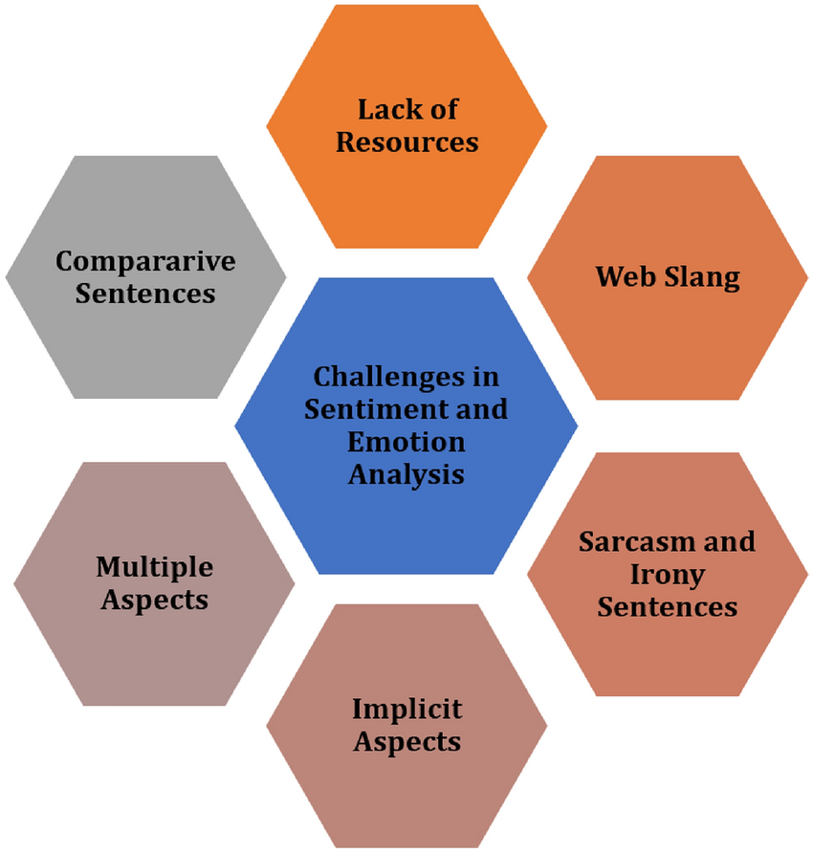
Challenges with Sentiment Analysis
Lack of Context
Subjectivity and Sarcasm
Sentiment analysis algorithms can often miss contextual cues, providing inaccurate analyses.
Difficulties in measuring sentiment accurately with highly subjective language and sarcasm.
.

Slide 19

Conclusion and Future Applications
Future applications
Our sentiment analysis program can be used to predict the public response on elections, political events, and social movements and also for business market .
1
2
3
Conclusion
Ideas for Further Development
The approach we used in this project are data preprocessing, machine learning, and data visualization, making it a useful application of computer science in public opinion analysis.
Combining Twitter data with sources like news articles to expand the data pool in future versions of this project.

